Slide 1
Database System
Lecture 5

Slide 2
ER Model Notation Overview
Entity-relationship diagrams, also called ERDs or ER diagrams, are flowchart-like diagrams that explain the structure of entities, attributes, and their relationships in a database.
They are mainly used for relational database design, and can be used to troubleshooting designs.
There are many notations and symbols that are unique to ERDs that you need to know in order to read and create them.

Slide 3
ER diagram notations and symbols
In ER diagrams entities are represented with rectangles, attributes are represented by ovals or inside entities, and relationships are shown in diamonds or with lines.
There are three notation types:
Chen Notation
Crow Notation
UML Notation

Slide 4
Chen notation symbols
Peter Chen, the creator of Chen’s notation, invented this more detailed way of notation in 1976.
Chen’s notation was one of the first to be used in software design, and is still popular in ERD creation.
Unlike Barker’s notation and UML, entities, relationships, and attributes have many different ways of being represented.

Slide 5
Chen notation symbols
An entity is shown in a rectangle, just like in many other notations. But, that is where the similarities stop. There are 2 more ways to describe entities:
Weak entity – A rectangle within a rectangle
Associative entity – A diamond within a rectangle
Attributes are in ovals. Here are some other symbols used to define attributes:
Key attribute – The title of the attribute is underlined
Partial key attribute – The attribute’s name is underlined with a dashed line
Composite attributes – These attributes branch off from a larger attribute, and are a different color
Multivalued attribute – An oval within an oval
Derived attribute – An oval with a dashed line
Relationships are defined with optionality, cardinality, degree, participation, and type; using lines and diamonds.
Strong relationship – A solid-lined diamond
Weak relationship – A diamond within a diamond, like a weak entity

Slide 6
Chen notation symbols
Cardinality (degree)
One to one – A 1 is at each end of the relationship
One to many – A 1 is at one end, and N is at the other. N represents ‘many’.
Many to one – Like one to many, but reversed
Many to many – M is on one end, and N is on the other

Slide 7
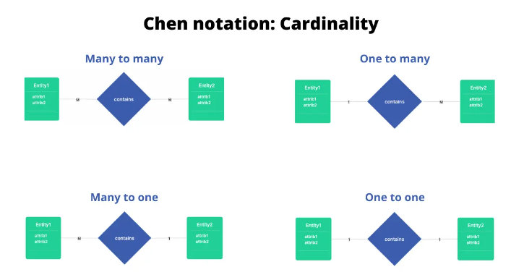

Slide 8
Crow notation
Crow’s foot notation, often called just Crow notation, in which, Entities are in rectangles with their attributes inside.
Relationships are defined much like they are in other notations, but major difference is the presence of multiplicities.
Multiplicities are symbols that tell the reader the number of times instances can associate with others.

Slide 9
Crow notation symbols: Multiplicity symbols
There are two marks that indicate multiplicity.
The first mark, closest to the end of the line, represents the maximum number of times an instance of an entity can be associated with other instances
One time – A short, perpendicular line
Many – A three-pronged line, like in Barker’s notation
The second mark, behind the first, represents the minimum number of times an instance of an entity can be associated with other instances. The minimum can only be zero or one, and they are referred to as ‘optional’ or ‘mandatory’, respectively.
Some of the crow’s foot notation relationships are one-to-many, one-to-one, and many-to-many.
Optional – An open circle
Mandatory – A short, perpendicular line

Slide 10
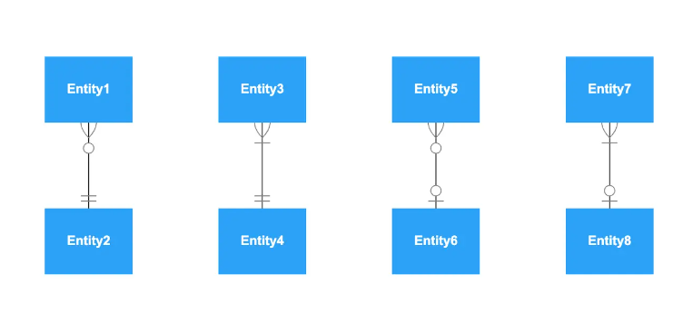

Slide 11
UML notation
UML, which stands for Unified Modeling Language, is extremely popular and used in many different diagram types.

Slide 12
UML notation symbols
Entity – Rectangle shape
Generalization – Empty arrow at the end of a relationship line
Aggregation – Empty diamond at the end of a relationship line
Composition – Filled in diamond at the end of a relationship line
Relationships only have solid lines, and have numbers signifying cardinalities at the end of the line. There are a few ways to show cardinality.
Zero or one – 0..1
Only one – 1
Zero or more – 0..*
One or more – 1..*
Specific range – n..m

Slide 13
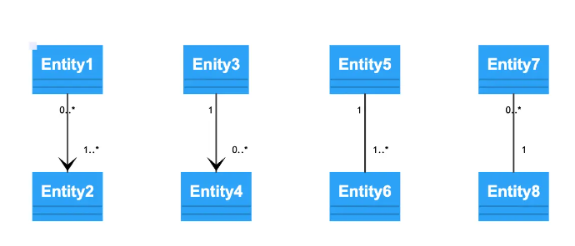

Slide 14
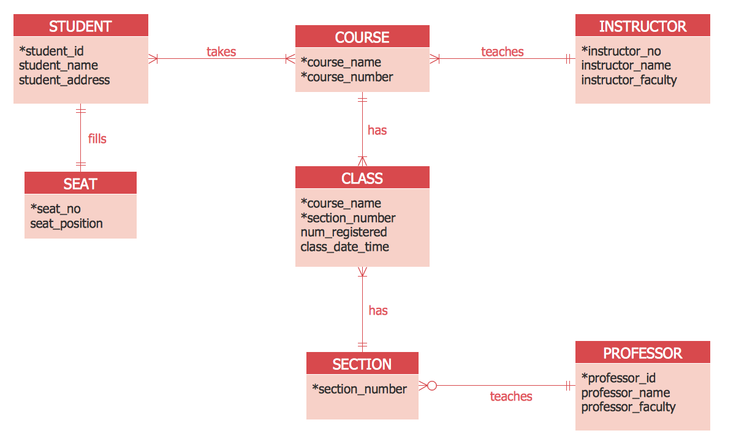

Slide 15
